Slide 1
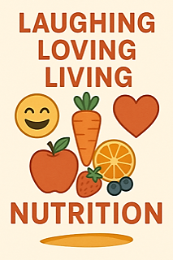
Top 3 Power Habits
Paula Ruiz, MS, RD, LDN
paula@feelaliveandwell.com | (225)938-4802

Slide 2
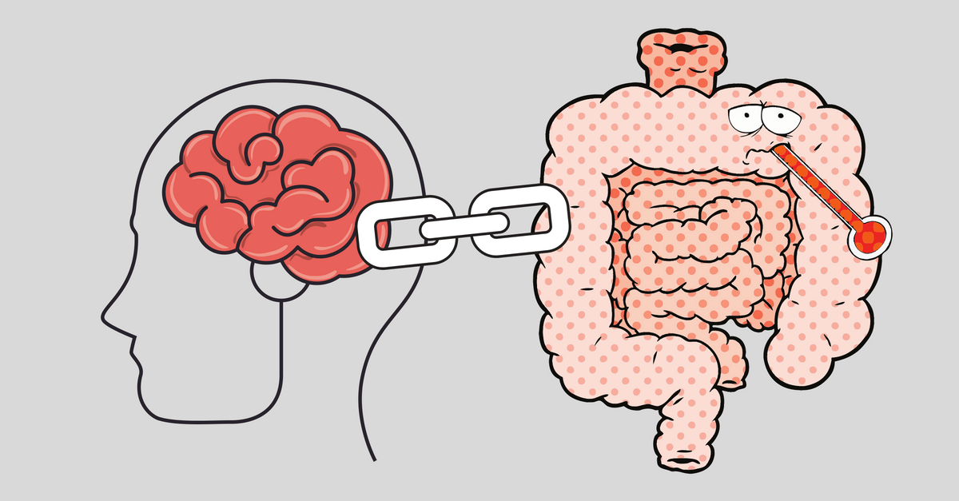
Why Habits
Matter More
After 50:
After 50, changes in digestion, hydration and metabolism are common.
Many chronic issues-fatigue, weight gain, poor digestion and brain fog- are linked to daily habits.
The good news? You can improve your quality of life with a few simple changes- at any age!

Slide 3

Habit #1: Take 5-6 Slows Breaths Before Each Meal
WHY?
Most people eat while stressed or distracted
7/10 are in a chronic state of stress
Your body diverts energy away from digestion to prepare for “fight or flight”, shutting down 70% of your digestive capacity. (Source: Harvard Health Publishing).
Deep breathing turns off your fight or flight stress response. It signals your nervous system to reallocate blood flow back to your digestive organs so your body rest, digest, and heal itself properly.

Slide 4
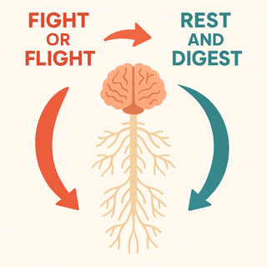
Deep Breathing = Quick Nervous System Reset
Slow, deep breathing gently stimulates your vagus nerve, which connects your lungs, heart and brain. In 30 seconds, the body gets the message that it’s safe.
This simple & quick action quickly turns off fight or flight stress response and turns on parasympathetic nervous system (“rest and digest”).
Result: Better digestion, nutrient absorption, and satiety.

Slide 5
Digestion When Stressed vs. Calm (Part 1)
Feature | During Stress ('Fight-or-Flight') | During Relaxation ('Rest-and-Digest')
Nervous System | Sympathetic Nervous System is active | Parasympathetic Nervous System is active. Just 6 breaths before eating lowered cortisol up to 25% (Clinical Endocrinology & Metabolism)
Blood Flow | Redirected away from the gut to muscles and brain | Increased to the digestive tract. Slow breathing lowered systolic BP by 10 mmHg in 2 weeks (Hypertension Research)
Gut Motility | Disrupted, leading to spasms, constipation, or diarrhea | Promoted and regulated for efficient food movement

Slide 6
Digestion When Stressed vs. Calm (Part 2)
Feature | During Stress ('Fight-or-Flight') | During Relaxation ('Rest-and-Digest')
Digestive Enzymes | Production decreases, leading to inefficient digestion | Production increases, aiding in proper food breakdown
Stomach Acid | Production can increase, raising risk of acid reflux | Regulated to optimal levels
Gut Microbiome | Balance is disrupted, potentially causing inflammation | Balance is maintained, promoting digestive and immune health
Common Symptoms | Bloating, nausea, indigestion, ulcers, IBS | Healthy digestion and nutrient absorption. Mindful eaters consumed 20–30% fewer calories (Appetite, 2014)

Slide 7
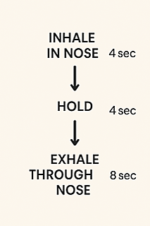
Breathing Guide
Repeat 5–6 times
(~30 seconds)
Enjoy your meal 😊

Slide 8

Habit # 2: Hydrate Daily 💧
Why? Water is essential for every cell, tissue, organ, and bodily process.
Most are mildly dehydrated = 30% less energy
Dehydration is most common contributor to:
Fatigue
Poor Digestion & Constipation
Stiffness, Muscle and Joint Pain
Brain Fog, Dizziness & Headaches

Slide 9
Hydration Matters More as We Age (Part 1)
Feature | Hydrated Retiree | Dehydrated Retiree
Brain Health | Brain 75-80% water Sharp focus | Even mild dehydration shrinks the brain, causes problems with memory, attention & concentration. Older adults show 25% slower response times when dehydrated (Journal of Nutrition, 2012)
Joint & Muscle Comfort | Muscles 73% water; Bones 20–25% water. Synovial fluid lubricates all joints. Smooth movement | Poor water intake causes inflammation and friction, worsening arthritis & stiffness
Vascular Health | Heart 75–80% water; Blood 83% water. Stable heart rate & BP. Proper hydration ↓BP up to 10 pts. Drinking 2 cups of water ↓systolic BP in older adults (Hypertension Research, 2019) | Reduced blood volume increases heart workload, elevating heart rate & BP

Slide 10
Hydration Matters More as We Age (Part 2)
Feature | Hydrated Retiree | Dehydrated Retiree
Vision | Eyes 98% water Improved eye moisture & clarity | Dry eyes, strained or blurry vision
Skin | 70–75% water Elastic, glowing skin with fewer wrinkles & faster wound healing | Dry, flaky skin, more wrinkles, slower wound healing
Digestion | Intestines 75% water Optimal digestion & absorption. | Poor water intake pulls fluid from colon and increases constipation.
Immune Function | Lymph 94% water; Lungs 75%; Liver 70–75% Strong immunity | Weak immunity

Slide 11
Hydration Matters More as We Age (Part 3)
Feature | Hydrated Retiree | Dehydrated Retiree
Kidney Function | Kidneys 80–85% water Drinking water ↓ risk of UTIs & kidney stones by 50% | ↓ Detoxification, kidney strain
Sleep | Deeper sleep with fewer nighttime awakenings | Dry mouth, leg cramps, frequent urination = disrupted sleep
Fall Risk | Low fall risk, better balance & coordination | 37% higher fall risk due to dizziness & weakness
Mood | Water regulates body temperature and ↑ oxygen delivery for energy & mood | Low water intake ↑ cortisol by 55%, linked to stress, irritability & depression (Journal of Applied Physiology)

Slide 14
Habit #3: Eat Balanced, Whole Foods Meals
🥦 1/2 Plate = Non-Starchy Vegetables
• Example: leafy greens, broccoli, cauliflower, zucchini, peppers, asparagus, cabbage, mushrooms
• Why: High in fiber, antioxidants, water, and essential nutrients; low in calories but high in volume and satiety.
🍗 1/4 Plate = Lean Protein
• Animal: chicken, fish, eggs, turkey, grass-fed beef
• Plant: lentils, beans, tofu, tempeh, edamame, quinoa
• Why: Provides amino acids for muscle, immune function, hormones, and blood sugar control.
🍠 1/4 Plate = Smart Carbohydrates
• Whole grains: quinoa, brown rice, oats, farro, buckwheat
• Starchy veggies: sweet potatoes, squash, corn, peas
• Legumes: black beans, lentils
• Why: Fuel for energy, brain function, and fiber to support gut health.
🥑 Add Healthy Fats (1–2 tbsp or a small handful)
• Examples: avocado, olive oil, nuts, seeds, olives, tahini
• Why: Supports brain health, hormones, and helps absorb fat-soluble vitamins (A, D, E, K).

Slide 15
What’s On Your Plate
🚨 Ultra-Processed Food
Industrial products made mostly from refined ingredients, additives, and chemicals, with little to no whole food left.
Examples: Sugary cereals, soda, chips, fast food, instant noodles, white sandwich bread, muffins, pastries, packaged snacks, deli meats, chicken nuggets, frozen meals.
Adults get 60% of total calories from ultra-processed food (CDC, 2023).
⚠️ Processed Foods
Foods changed from their natural form for shelf life, taste, or convenience, but still recognizable as food.
Examples: Canned beans, yogurt, cheese, whole wheat bread, pasta, rice, nuts, sauces, soups, peanut butter.
Adults get 10–20% of total calories from processed food (CDC, 2023).

Slide 16
Whole Foods
🍎 Whole Foods - Foods in their natural state, or very close to it with little or no processing.
• All raw, steamed, roasted vegetables, fresh or frozen fruit with no added sugar, whole grains such as brown rice, quinoa, steel/rolled oats in full form not milled into flour with other additives, all beans and peas dried or canned if no added salt/preservatives, all raw or dry roasted nuts & seeds no added oil or salt, all protein cooked without processed sauces - eggs, fresh unseasoned chicken or turkey, fresh fish, grass fed beef, plain milk (dairy or unsweetened plant-based), fresh herbs, mushrooms.
• One ingredient foods, minimally packaged, no added salt, sugar, fat or preservatives.
• Adults get 25–35% of calories from whole/minimally processed food (CDC, 2023).
Whole Food Meal Examples:
✅ Grilled salmon, quinoa, and steamed broccoli with olive oil
✅ Oatmeal with chia seeds, berries, and almonds
✅ Chicken stir-fry with mixed vegetables and brown rice
✅ Tacos with grilled chicken, avocado, salsa, and black beans

Slide 17
Comparison: Balanced Whole Food Meals to Processed Meals (Part 1)
Feature | Balanced Whole-Food Meals | Average Processed Meals
Nutrient Density | Contain thousands of phytonutrients beyond vitamins & minerals that ↓ inflammation, ↑ detox, prevent disease (apple >10,000 phytonutrients) | Low in nutrients; often high in calories but lacking essential vitamins and minerals
Energy Levels | Steady, sustained energy from protein, fiber from plant foods & healthy fats | Rapid energy spikes and crashes due to refined sugars and low fiber
Blood Sugar Control | Stable glucose response and reduced risk of insulin resistance | Frequent spikes in blood sugar leading to fatigue and cravings
Heart Health | Supports healthy cholesterol and blood pressure; rich in omega-3s and antioxidants. Home meals 50–80% lower in sodium than restaurant & boxed meals | High in sodium, trans fats, and refined oils, increasing risk of heart disease

Slide 18
Comparison: Balanced Whole Food Meals to Processed Meals (Part 2)
Feature | Balanced Whole-Food Meals | Average Processed Meals
Digestion | High fiber ↑ gut health, regularity, removal of excess toxins, hormones & cholesterol. | Low fiber causes sluggish digestion and gut imbalance. Research shows people get ≤4.8 g fiber w/ processed food
Inflammation | Naturally anti-inflammatory from whole plant compounds | Pro-inflammatory additives, refined oils, and sugars
Weight Management | Encourages healthy metabolism and satiety; easier to maintain ideal weight | ↑ cravings looking for nutrients
Mood & Mental Clarity | Stabilized mood, improved focus, and fewer energy dips | Linked to anxiety, brain fog, and irritability
Longevity | Associated with lower rates of chronic disease and longer lifespan. Reduces risk of heart disease, stroke & T2D 50–80% | Higher risk of obesity, diabetes, heart disease, and early aging
Overall Feeling | Feels nourished, energized, and balanced | Feels bloated, fatigued, and sluggish

Slide 19
Food Chemical & Quality Comparison (Part 1)
Category | Whole Foods | Average Processed Meals
Pesticides | Usually minimal, especially when organic. Washing and peeling can further reduce residue. | Often contain ingredients from conventionally farmed crops with higher pesticide exposure.
Additives | Rarely used; flavor, color, and texture are natural. | Contain flavor enhancers, emulsifiers, stabilizers, and artificial sweeteners to improve shelf life and taste.
Preservatives | Not needed for fresh foods; refrigeration or freezing is used instead. | Heavy use of preservatives (like sodium nitrite, BHA/BHT) to prevent spoilage and extend storage life.

Slide 20
Food Chemical & Quality Comparison (Part 2)
Category | Whole Foods | Average Processed Meals
Artificial Dyes | Natural color comes from nutrients in fruit & veg | Commonly include synthetic dyes (e.g., Red 40, Yellow 5) for appearance consistency
Sodium & Sugar | Naturally low; flavor enhanced through herbs, spices, and natural ingredients. Home cooked meals (300–500 mg sodium/meal) | High sodium and added sugars for flavor preservation and palatability. Americans are getting 90% of their added sugar intake from processed food (Vanderbilt University). Restaurant/processed meals (1,200–2,500 mg sodium)
Overall Quality | Clean, nutrient-rich, and closer to natural form. Meals cooked at home have 25% less saturated fat (Foods, 2019) | Highly refined, low in nutrients, and often linked to inflammation. People consume 500 calories more/meal (NIH). Reports show Americans are getting 58% of their daily calories from processed food

Slide 22
✨ Start Today ✨
Start with one meal.
Just breathe, sip, and nourish.
🌟 Focus on consistency over perfection!
Thank YOU!
Paula Ruiz, MS, RD, LDN
Alive & Well, LLC
www.feelaliveandwell.com

